Slide 1


An investigation into voice-controlled web browsing for the elderly
ELEN4012 : Information Engineering Laboratory
Authors: Cole Noble, Kirti Nathoo
October 2011

Slide 2
Outline
Voice-controlled web browsing for the elderly
Background
Objectives
Software Application
Testing and Results
Analysis
Team Work
Conclusion
Future Work

Slide 3
Background
Background
Statistics show growing use of computers by the elderly.
US stats:
People over 65 are the fastest growing group of new internet users.
13% of population is comprised of the elderly.
4% of total internet usage is contributed to by the elderly.
Eastman J. K., Iyer R. The Elderly uses and attitudes towards the Internet. Journal of Consumer Marketing, Vol 21 Iss: 3, 2004, pp208-208.
Notes:
Reasons [1]
No previous interaction with computers
Reluctance to use new technology
Physical difficulty in using the keyboard

Slide 4
Background
The internet offers online shopping entertainment, banking and communication.
Why is such a large portion of the US population not using the internet?
Computer literacy.
Health conditions.
Anderson S. , Liberman N., Bernstein E., Foster S., Cate E., Levin B. Recognition of Elderly Speech and Voice-driven Document Retrieval. IEEE. Vol 1, 1999.
Notes:
The internet offers online shopping, entertainment, banking and provides a means of instant communication. There is a massive group of people that require access to the functions.

Slide 5
Speech Recognition
Background
Form of assistive technology for people with disabilities.
Speech controlled web browsing improves the usability of computers for the elderly.
Anderson S, Liberman N, Bernstein E, Foster S, Cate E, Levin B. Recognition of elderly speech and voice-driven document retrieval. Dragon Systems, Inc, 1999 IEEE, pp 1.
Conn N, McTear M. Speech Technology: A Solution for People with Disabilities. Faculty of Informatics, University of Ulster at Jordanstown, United Kingdom, 2000 IEEE, pp 1.
Notes:
Speech technology is a form of assistive technology that offers potential benefits for people with a wide range of disabilities. In particular, for people with physical disabilities.[Speech Tech - PDF]. Speech technology is said to enhance the quality of life for the elderly.
Speech recognition technology can greatly enhance the quality of life. [Speech Tech - PDF]
Speech controlled internet browsing does not require a great deal of typing and is the optimal starting point to improve the usability of computers for the elderly.[Speech browsing elderly - PDF]

Slide 6
Objectives
Objectives
Determine which speech recognition
techniques improve the usability of web
browsing for the elderly.
Determine whether Numerical or Link name
referencing techniques:
Perform better and,
Are preferred by elderly users.
Notes:
Determine the following objectives in context of elderly users.
The 2 referencing techniques are: numerical referencing and link name referencing. In numerical referencing each link on a page is assigned a numeric identifier. In link name referencing each link on a page can be accessed by saying the link name.

Slide 7
Objectives
Determine which visual and verbal feedback
techniques assist elderly users during web
browsing.
Create a suitable platform for further
investigation into improving computer
usability for the elderly.
Notes:
Determine what feedback techniques or combinations of feedback techniques, are preferred by the elderly. Visual feedback techniques include pop-ups, link highlighting. Verbal feedback refers to voice commands repeated back to the user. Both techniques assist in notifying users of which element is selected on a page.

Slide 8
Software Application
Software Application
Components.
Design.
Implementation.
Notes:
Objectives required a focus on testing, testing was thus carried out by creating specific websites that enabled voice recognition and forms of feedback (to enhance prototype creation speed). The websites were decomposed into components and iterations for each website was designed and implemented.

Slide 9
Components
Software Application
Voice processing
Visual rendering
Navigation
Notes:
Project divided into components.
Visual processing (presentation of website and associated feedback techniques). Visual processing refers to graphical web development. The application provides users with an interactive web page GUI. Done by Kirti Nathoo.
Voice processing (voice referencing techniques and associated logic). The voice recognition component enables users to interact with the application GUI through the use of voice commands. Done by Cole Noble
The navigation component refers to website navigation and integrates both the visual rendering and voice recognition components.

Slide 10
Design
Software Application
Iteration 1:
Referencing technique performance
Visual feedback technique
preference
Verbal feedback
technique
preference
Notes:
The Rapid Application Development (RAD) method is followed. RAD is an agile method wherein requirements are prioritised into iterations to ensure
essential requirements are met first. Discuss the requirements for each iteration.
Determine the performance between numerical and link name referencing techniques for simple websites. Number of errors for referencing techniques and
preference for feedback were recorded
Determine which visual feedback techniques – pop ups or link highlighting – are preferred by users.
Ascertain if users would like verbal feedback whilst using the application.
Perceived performance and preference of the techniques were also noted.

Slide 11
Software Application - Design
Iteration 2:
Warm up tutorial for each technique
Referencing technique performance
Notes:
Investigate the performance of numerical and link name referencing techniques for simple web pages.
Include a tutorial before each section and determine if this is beneficial to users and differs from results previously obtained in iteration one.
Remove feedback techniques which have been previously tested and adequate results were obtained.
Ascertain if users prefer saying a particular word, part of or the complete sentence for the link name referencing technique.

Slide 12
Software Application - Design
Iteration 3:
Referencing technique performance
Combination of feedback techniques
Button to activate voice recognition
User confirmation
More complicated website
Notes:
Determine the performance of numerical and link name referencing styles on complex websites. Determine which technique users prefer.
Determine user response to a combination of feedback techniques.
Ascertain if users think it’s reasonable to expect elderly users to press a button to activate voice recognition each time they speak.
Determine the necessity of user confirmation. (additional interface requirements)
Determine if users would prefer a non-internet based application.

Slide 13
Implementation
Software Application
Voice recognition.
Visual rendering.

Slide 14
Voice recognition
Software Application - Implementation
Online API from SpeechAPI.com.
Embedded flash component used for
streaming.
JavaScript used to process string results.
More advanced functionality available.

Slide 15
Visual rendering
Software Application - Implementation
Layout.
Components.
Screenshots.
HTML and CSS.
Notes:
The visual rendering section relates to the application Gui through which users interact with the application. For the visual rendering section we’ll look at the layout of the web pages. The components that were used to design the web pages. These are shown as screenshots.

Slide 16
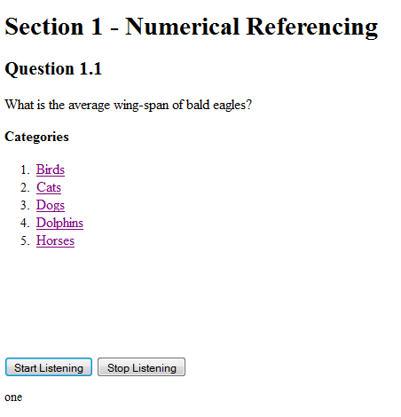
Software Application - Implementation
Iteration 1 – Numerical Referencing
Notes:
For it 1, a simple website composed of questions and answers has been developed. The questions and answer relate to animal facts for interest for users. The website is divided into sections and numerical and link name referencing techniques have been applied.
For the numerical ref section, first start of the website with a question (say question). Thereafter the user is provided with 5 different categories. To select a category wherein you think the answer lies, say the corresponding number.
To initialise speech recognition and to say the number, the space bar button on the keyboard must first be pressed and released. After answering a question the button must be pressed again to notify the API that the user has completed speaking.

Slide 17
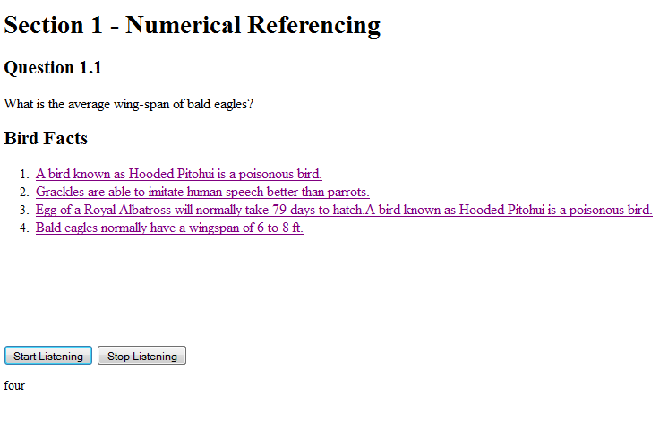
Software Application - Implementation
Numerical Referencing
Notes:
The user is then shown 4 facts. To select the correct fact, the user is required to say the associated fact number. In this case, the correct answer is fact number 4. The user is required to say 4.
Again, the buttons must be selected to activate and deactivate the speech recognition.
The numerical referencing section consist of 5 questions.

Slide 18
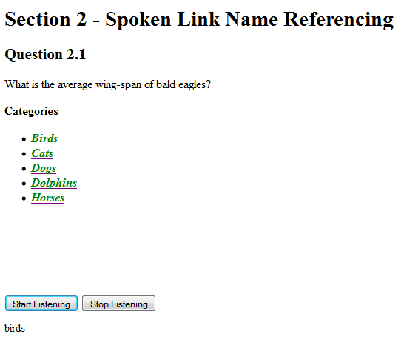
Software Application - Implementation
Link Name Referencing
Notes:
Then we move onto the link name referencing sections. The same five questions from the numerical section are repeated to avoid additional complexity and confusion.
The same question on birds but now to answer questions in the link name referencing section, the green highlighted text must be said. So in this case the user is required to say birds.

Slide 19
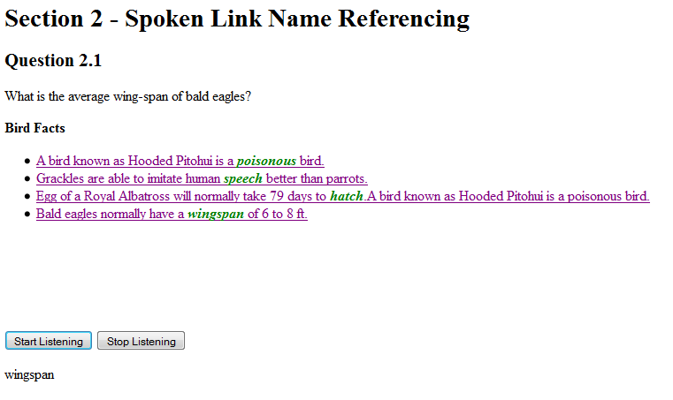
Software Application - Implementation
Link Name Referencing
Notes:
The user is again shown the 4 facts and the last fact is the correct answer. But the user must say the word in the sentence that s highlighted in green and in this case the word is wingspan.

Slide 20
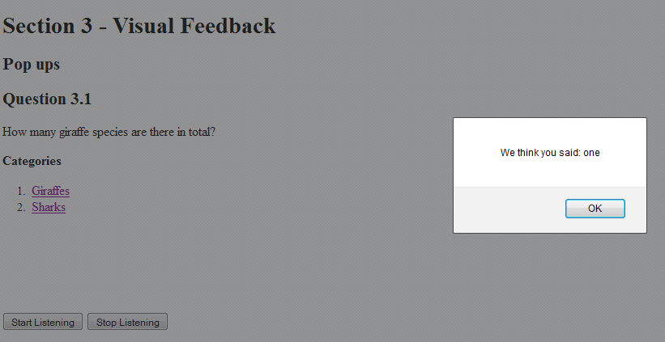
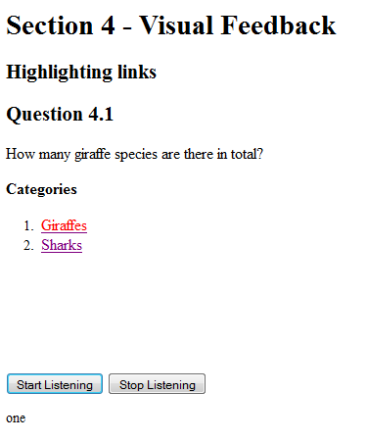
Software Application - Implementation
Feedback
Pop ups
Link Highlighting
Verbal feedback
Notes:
Three feedback techniques were implemented: These were pop ups, link highlighting and visual feedback.

Slide 21
Software Application - Implementation
Iteration 2
Tutorial sections.
No feedback sections.
Notes:
A large number of errors were recorded for the first referencing technique in iteration one, i.e. Numerical ref. To remain unbiased to a particular referencing style, the website in iteration one was restructured and tested again.
the website was restructured by including warm up tutorials before each section to guide the user on how to use the application.
In this instance all the feedback sections have been removed.

Slide 22
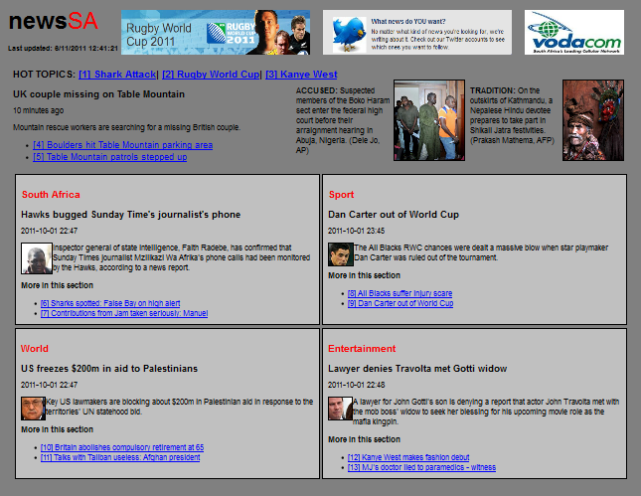
Software Application - Implementation
Iteration 3 – Numerical Referencing
Notes:
For the third iteration, A facsimile of a local news website was been designed. Numerical and link name referencing techniques have been applied to the website to determine the performance of these techniques on complex and realistic websites. Two versions of the website facsimile have been created. The numerical referencing technique is applied to the first version as indicated in the slide. Each link is accessed by saying the associated number. For e.g. For the first article on Shark Attack, the user is required to say 1.
To activate speech recognition for either of the websites, the ctrl button on the keyboard must be pressed before speaking.

Slide 23
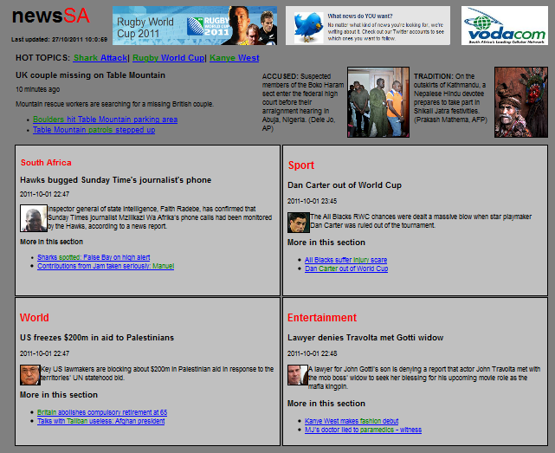
Software Application - Implementation
Link Name Referencing
Notes:
Link name referencing is applied to the second version of the website wherein links are accessed by saying the text highlighted in green. If the user wishes to read the first article on Shark Attack, the user is required to say the word in green, i.e. Shark.
Navigation commands such as up, down, home and backwards have been included for both websites.

Slide 24
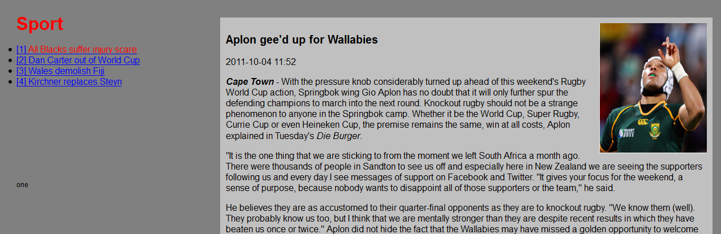
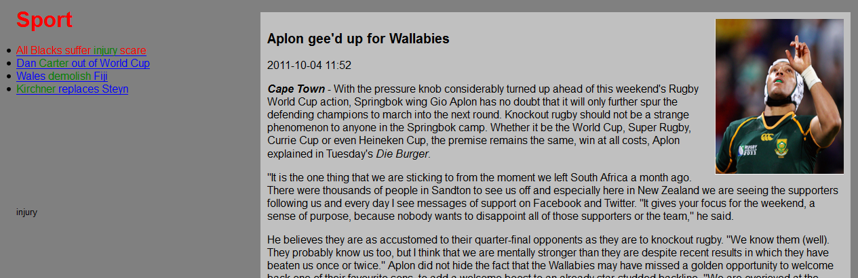
Software Application - Implementation
Feedback
Notes:
In terms of feedback, verbal and visual feedback has been incorporated into the websites. Verbal feedback has been incorporated where commands spoken by the user are verbally repeated back to the user. . Link highlighting has been provided as visual feedback. Upon selecting a link, the colour of the selected link changes to red to notify the user that the element is selected as shown in the above screenshots for numerical and link name referencing.
User confirmation has also been integrated into the application for complex navigation methods such as selecting a link or going backwards. After an action is selected by the user, yes or no verbal confirmation must be provided. In the event of recognition errors, users are requested to repeat the command Visual feedback and user confirmation ensure that correct elements are selected which improves the performance and accuracy of the voice navigation.

Slide 25
Testing and Results
Testing and Results
Iteration 1.
Iteration 2.
Iteration 3.
Secondary results.
Notes:
We going to look at the results for the three iterations and the secondary results are derived results from the application testing, i.e. additional findings that were observed after assessment.

Slide 26
Iteration 1
Testing and Results
Application errors:
Numerical referencing: 70%.
Link name referencing: 30%.
User preference:
Notes:
For the first iteration, first we look at the app errors. Application errors were cases wherein voice commands were misread, not recognised or not accepted
by the API.
In the numerical referencing section a total of 70% of application errors were recorded in comparison to the link name referencing section wherein 30%
errors were recorded. The high error percentage in the numerical referencing section may be due to the similarities between numbers spoken. Numbers
are short single syllable words that may decrease the accuracy of speech recognition. In addition, numerical ref was the first technique being tested and
users may have still been accustoming themselves to using the app.
For user preference between the 2 techniques, 57% of users prefer using numerical referencing for simple websites even thou a large number of app
errors were recorded. 29% prefer link name referencing and the remaining 14.% are fond of both techniques.

Slide 27
Testing and Results - Iteration 1
Perceived performance:
Feedback:
Notes:
The perceived performance is based on the users perception of how the ref technique performed.
57% of users felt that link name referencing performed better in comparison to the 29% of users felt that numerical referencing performed better. And the
remaining 14% felt that both technique performed well.
For the first iteration, 3 different feedback techniques were implemented. These were pop ups, link highlighting (explain) and verbal feedback. And upon
assessment it was ascertained that most users prefer link highlighting as a feedback technique.

Slide 28
Iteration 2
Testing and Results
Application errors:
Numerical referencing: 68%.
Link name referencing: 32%.
User preference:
Notes:
Iteration 1 was restructured as mentioned and retested.
In this case again more application errors (68%) was recorded for numerical ref in comparison to 32% for link name ref.
For the user preference in the second iteration, 60% of users still strongly prefer numerical ref with 20% of users fond of link name ref and the remaining 20% fond of both techniques.

Slide 29
Testing and Results – Iteration 2
Perceived performance:
Link name referencing:
Notes:
For the perceived performance in it 2, although 60% of users prefer numerical, none of the users felt that it performed well. However 60% of users
actually felt that link name referencing performed the best and the remaining 40% thought both techniques performed well.
For link name referencing, different techniques for accessing links was, i.e. Saying a particular word, the part of a sentence or link or the complete link.
80% of users prefer saying a specific word in comparison to the remaining 20% whom prefer saying the complete sentence. None of the users preferred saying part of a link.

Slide 30
Iteration 3
Testing and Results
Application errors:
Link name referencing: 54%.
Numerical referencing: 46%.
Equal user preference.
Button for speech recognition.
User confirmation.
Notes:
In it 3, for the application errors recorded, 54% of errors was recorded for link name referencing, whereas 46% were for numerical ref. So for more
complex websites more app errors were recorded for link name ref. This could due to the length and complexity of the words being spoken.
Between the 2 website versions, 50% of users prefer using numerical referencing and the other 50% of users prefer link name referencing.
Users were asked if it was unreasonable to expect elderly users to press a button to activate speech recognition. 50% of users felt that is was unreasonable
and the other 50% thought it was an acceptable requirement. This requirement is still debatable.
Users were questioned to ascertain if user confirmation was necessary and 63% of users felt that it was not necessary. The remaining 37% felt that
confirmation was necessary to ensure optimal performance of the application.

Slide 31
Secondary Results
Testing and Results
Application errors between males and
females.
Notes:
The secondary results are the additional results calculated.
The number of application errors between males and females were calculated. For each iteration the number of male and female users tested was recorded. Thereafter for each iteration, the total application errors for each gender was totalled and divided by the number of males and females respectively.
From the figure it is evident that females experienced substantially more errors than males in all three iterations. This large error rate may also be due to the fact that many of the females users tested were not computer literate and have never used a computer before. Additionally females speak softer and were much more nervous in comparison to the males whilst using the application.

Slide 32
Testing and Results – Secondary Results
Application errors per user age group.
Notes:
Thereafter the application errors per age group was determined.
Users were further categorised into age groups. Three age groups were defined: 55-65, 65-75 and 75-85 year olds. Application errors were tallied for each age group and divided by the number of users within that group and within each iteration.
From the figure, it is evident that for the first two iterations a higher number of application errors were recorded for the oldest age group of users tested as expected. However, unexpectedly in the third iteration the middle age group of users performed significantly worse than the eldest age group. This maybe because more users in the second age group were tested and consequently more errors were recorded in comparison to the number of users tested in the third age group.

Slide 33
Analysis
Analysis
Simple websites: Link name referencing.
Complex websites: Numerical referencing.
Notes:
The final analysis indicates that:
Numerical referencing performs better on complex websites in comparison to simple websites such as those in Iterations 1 and 2, where link name ref performs well.
From the figure it is evident that the highest total of application errors was recorded in iteration three. This may be attributed to the fact that iteration three
consisted of a more complex website. Errors recorded between iteration one and two slightly decreased after restructuring the first iteration. However
between the referencing styles, it was evident that for simple websites numerical referencing resulted in far more errors than link name referencing. This
may be due to numbers being short single syllable words. For complex websites link name referencing indicated substantially more errors thank numerical
referencing. These errors are the result of complex words, mispronunciations, etc.
The application errors also indicate that numerical referencing can be user to improve voice recognition errors for the elderly in simple websites.

Slide 34
Analysis
Users prefer Numerical referencing for simple
websites.
Combinations of Numerical and Link name referencing techniques.
Notes:
For user pref of ref techniques, as observed in the figure it is evident that for simple websites designed in iterations one and two, users preferred numerical
referencing. Even though link name referencing performs better. This may be due to the sequential nature and concise vocabulary of numbers. However for complex websites there was no distinct preference between referencing techniques. For complex websites, both techniques appear to be satisfactory.
The figure implies that possible combinations of numerical referencing and spoken link name referencing could be used (for instance, numerical referencing within sections and link name referencing for sections etc.)

Slide 35
Team Work
Conclusion
Fair work division.
Git and Github version control.
Email.
Instant messaging.
Notes:
The project components were fairly divided between team members which enabled easy integration later in the project. Voice processing – Cole, Visual processing – myseld.
Git was used to collaborate code contributions to the web application.
Github was used to centralise version control. This also increased acted as an additional backup and way of rolling back to prior versions of the project if need be.
Electronic mail and instant messaging services were used for communication between the developers.

Slide 36
Conclusion
Conclusion
For simple web pages:
Users prefer numerical referencing.
Link name referencing performs better.
For complex web pages:
No distinct preference.
Numerical referencing performs best.
Link highlighting and verbal feedback are adequate feedback techniques.
Age and gender have significant affects.
Notes:
In conclusion, for simple web pages although user prefer numerical ref, link name ref performs significantly better.
For complex web pages, there is no distinct preference between the techniques BUT in terms of performance, numerical ref performs best.
Link highlighting and visual feedback technique are adequate feedback techniques.
Age and gender have significant affects on voice recognition performance.

Slide 37
Future Work
Future Work
Algorithm for Link name referencing.
“Smart” command analyzer.
Stand-alone speech engine.
Cross-platform web browser add-on.
Notes:
Algorithm to automatically select key words to be spoken for link name referencing.
“Smart” command analyzer will be able to accept alternative commands. For e.g., back and backwards.
Stand-alone speech engine will be specifically trained for elderly male and female voices.
Create a generic web-browser add-on with customizable options for elderly (highlighting and section colours, voice referencing styles).

Slide 38
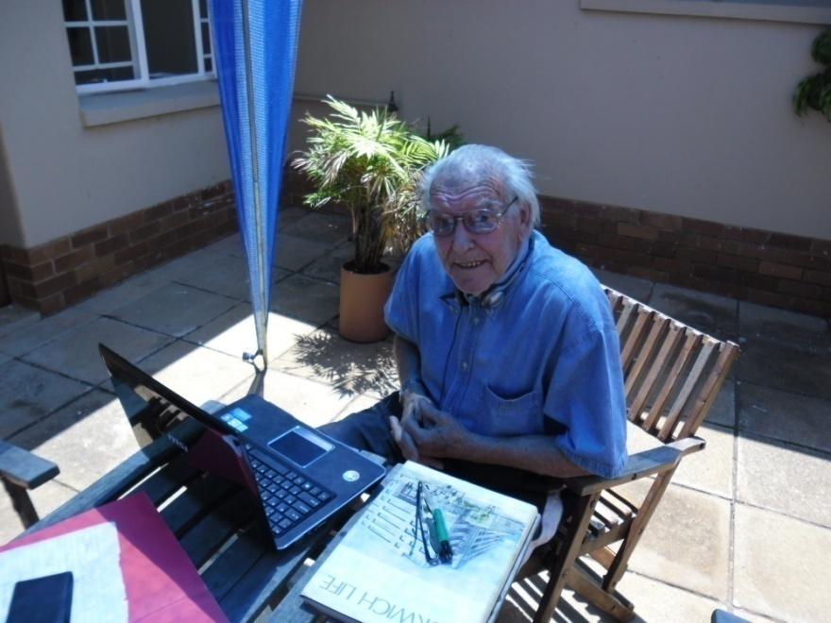
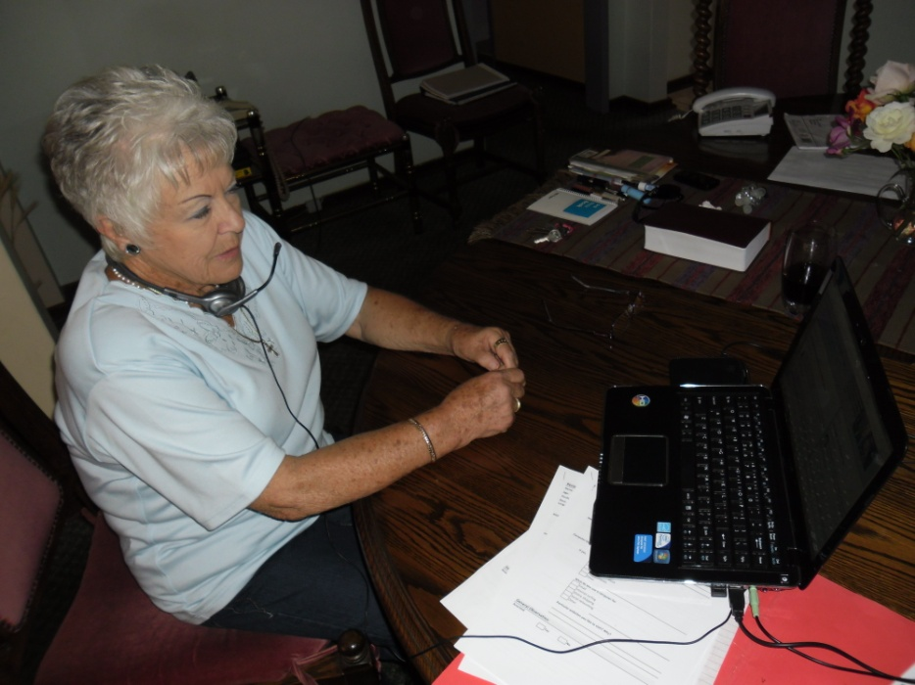
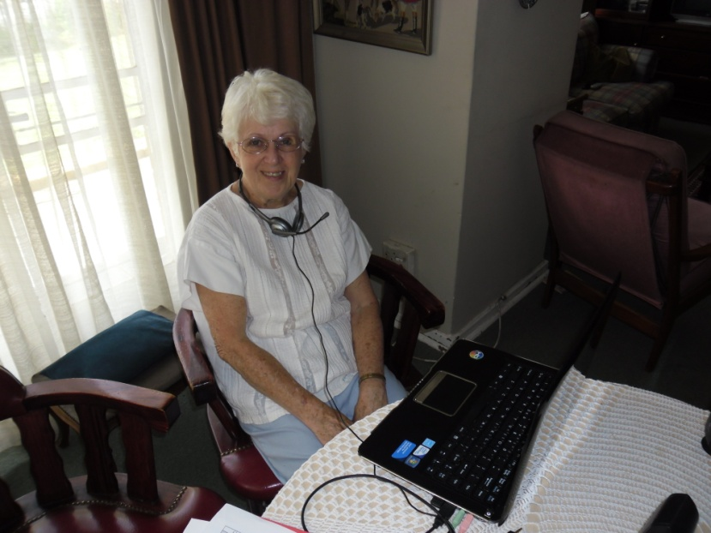
The End
Notes:
To end, these are a few images of the elderly whom were tested.

Slide 39
Questions ??
Questions
Notes:
Questions

